Slide 1

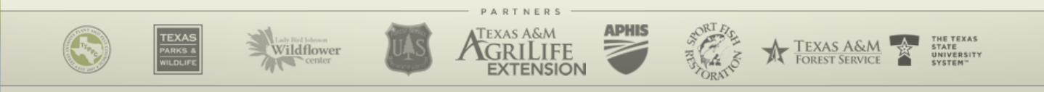
Identification and Management of Invasive Plants
USDA-APHIS
Texas Invasive Species Institute (TISI)
SHSU Agriculture Sciences
SHSU Engineering Technology

Slide 2
TEKS / OBJECTIVES
TEKS: 130.25 15 (A-E) The student evaluates components of plant science as they relate to crop production
Objectives:
Student will discover the proper invasive species for each region in Texas.
Student will determine proper invasive species through interactive modules.

Slide 3

Anticipation Questions
What is the most common way Invasive Plants spread to the United States?
Why do some areas of Texas have more Invasive Plants than others?
How can you prevent the spread of Invasive Plants? Or help with management?

Slide 4
Best Management Practices
Use an Integrated Pest Management strategy because invasive plants are very persistent and resistant to just one form of treatment.
Treat early and often!
Choose the appropriate management technique:
Mechanical
Biological
Chemical (but think about precautions!)
License required? (Call a professional!)
Read AND FOLLOW label instructions
Caution near aquatic habitats
Wear protective gear
Beware “drift”
Monitor (seed bank/resprout), Repeat and Plant Natives!
Notes:
Emphasize
Follow instructions
Wear protective gear
Hire professional when appropriate
Monitoring is really important

Slide 5
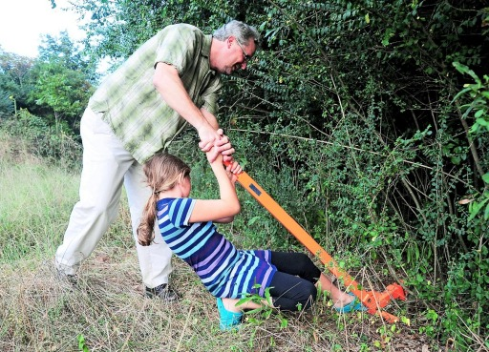
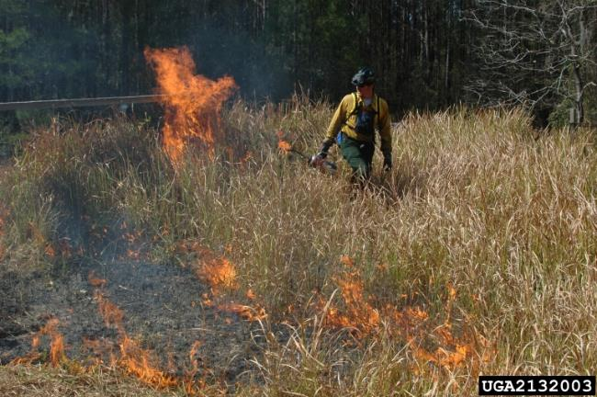
Mechanical
Hand pulling
Effective on small sprouts.
Weed wrenching
Very effective for plants that cannot be hand-pulled.
Best method for avoiding herbicides
Grazing
Only works if the plant is non-toxic to animals and if they’re willing to eat it.
Prescribed Fire
Requires a trained professional
http://www.weedwrench.com/

Slide 6
Chemical
Follow all labels and directions
Do not overuse & only use when needed
BE SELECTIVE
USE PESTICIDES WISELY: ALWAYS READ THE ENTIRE PESTICIDE LABEL CAREFULLY, FOLLOW ALL MIXING AND APPLICATION INSTRUCTIONS AND WEAR ALL RECOMMENDED PERSONAL PROTECTIVE GEAR AND CLOTHING. CONTACT YOUR STATE DEPARTMENT OF AGRICULTURE FOR ANY ADDITIONAL PESTICIDE USE REQUIREMENTS, RESTRICTIONS OR RECOMMENDATIONS. MENTION OF PESTICIDE PRODUCTS ON THIS WEB SITE DOES NOT CONSTITUTE ENDORSEMENT OF ANY MATERIAL.

Slide 7
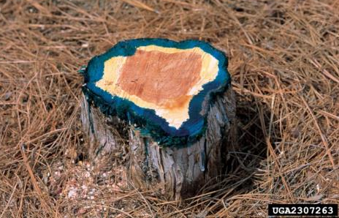
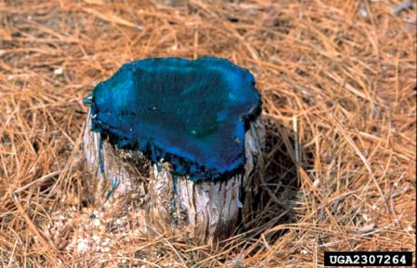
Cut and Treat
Very effective and focuses herbicide application.
For larger trees that can not be weed wrenched.
Cut at base and apply herbicide around edges of stump.
Use paint brush to focus herbicide application
Herbicide must be applied within 5 minutes of tree cutting.
Otherwise, the tree produces a protective layer that prevents the herbicide from being absorbed.

Slide 8
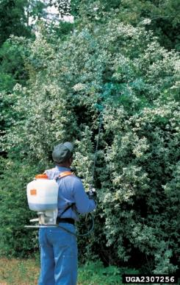
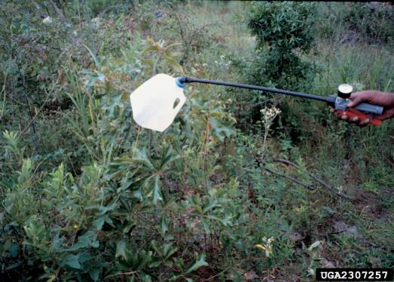
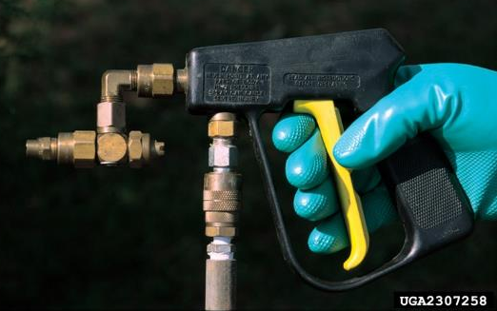
Direct Foliar Spray
Very cost effective
Uses this method for “foliar active herbicides”
Use proper nozzle for job and spray shield to reduce accidental spray.
Wear a mask when applying! Herbicides are harmful to humans if ingested.
Do NOT apply during rainy periods, or the chemicals will wash away.
Watch the plant’s flowering cycle to be most effective.

Slide 9
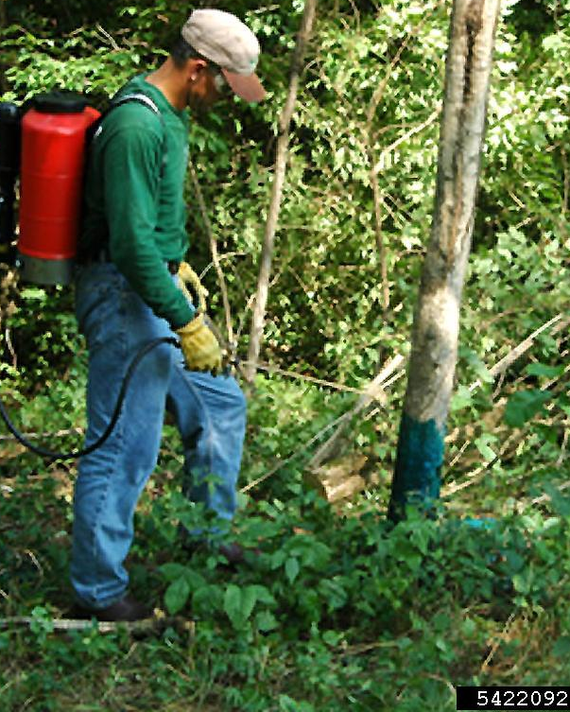
Basal Spray
Very selective
Applied to trunk vs. leaves like foliar spray
Herbicide-oil mix sprayed or painted to the lower portion of trunk
Must apply to bottom 12-14” all the way around
Most effective on smaller trees.
Before bark becomes corky and rough

Slide 10
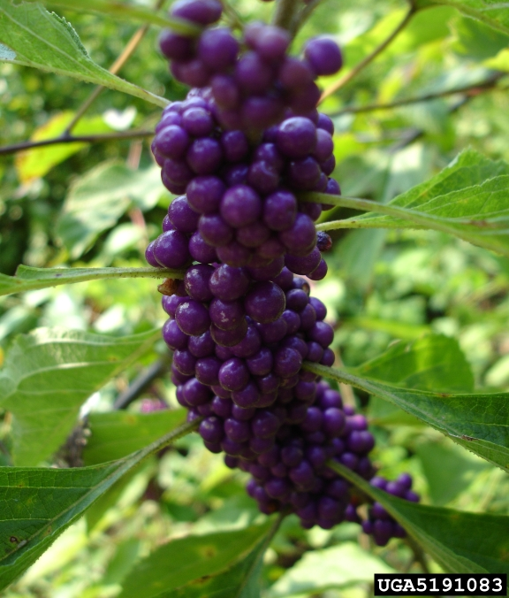
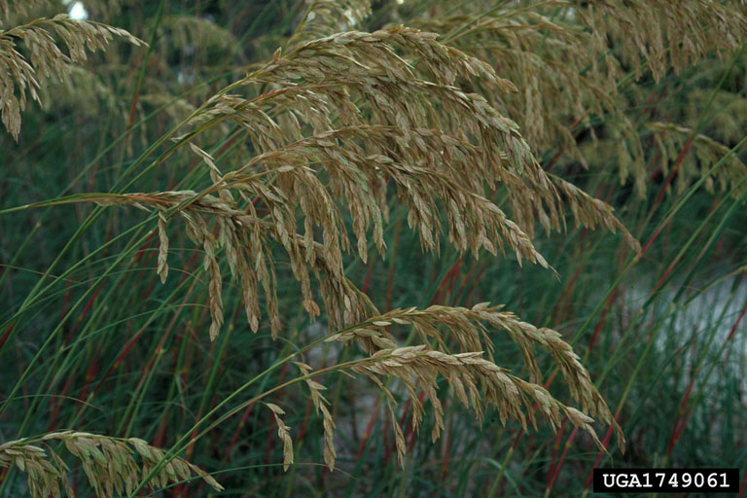
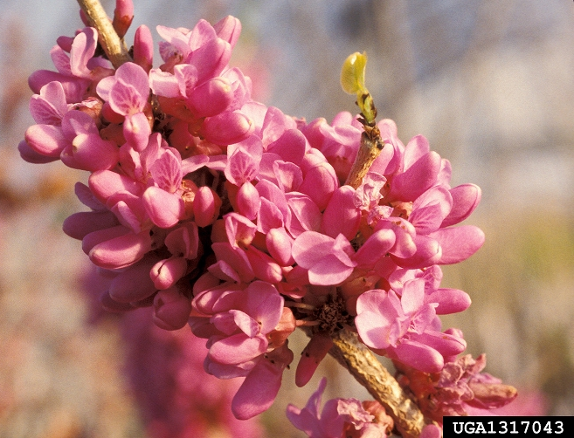
The most important step…
The Rehabilitation Phase
You can’t just cut down invasive plants! They will regrow!
Replanting and reseeding native species is vital to keep down re-sprouting invasives.
American Beauty Berry
Native Seaoats
Eastern Redbud

Slide 11
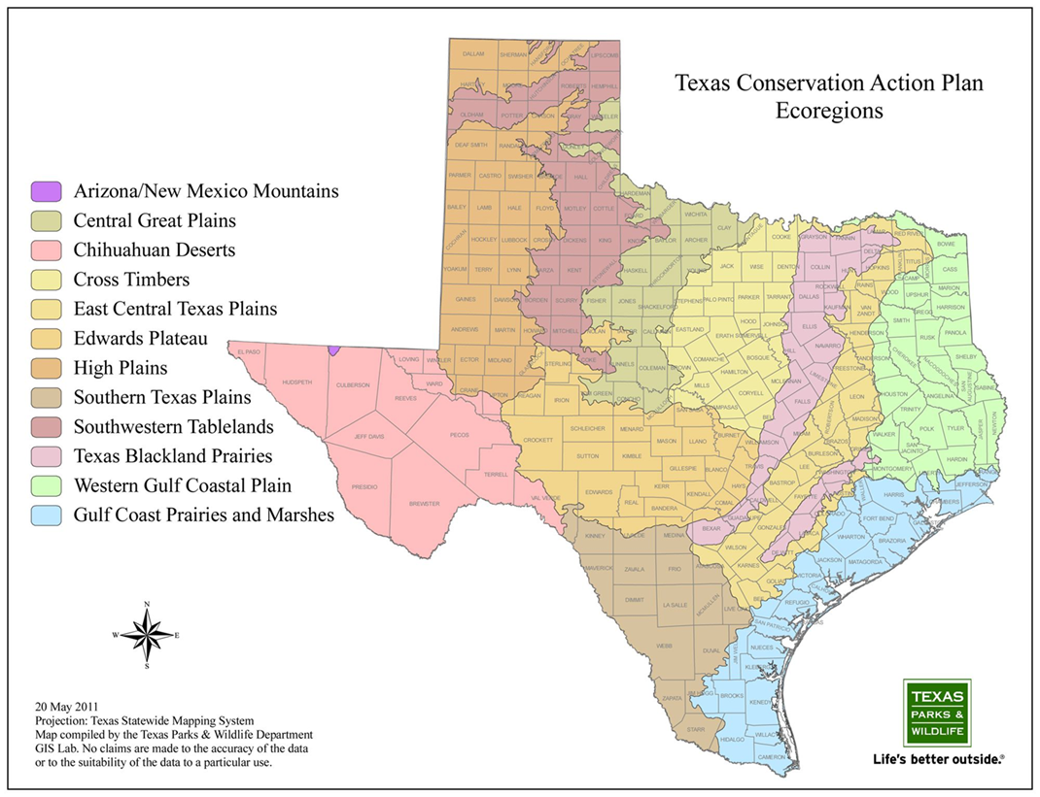
Ecoregions Review
Students can use the Ecoregion animation to review:
Invasive plants found in each area and identifying characters of the plants.
They can also review at:
Texasinvasives.org
Tsusinvasives.org
Notes:
TEACHERS PLEASE NOTE:
You can have students use this animation in lieu of going through every plant species listed in the next slides.
Also, this Ecoregion Review is used again at the end of this lesson

Slide 12
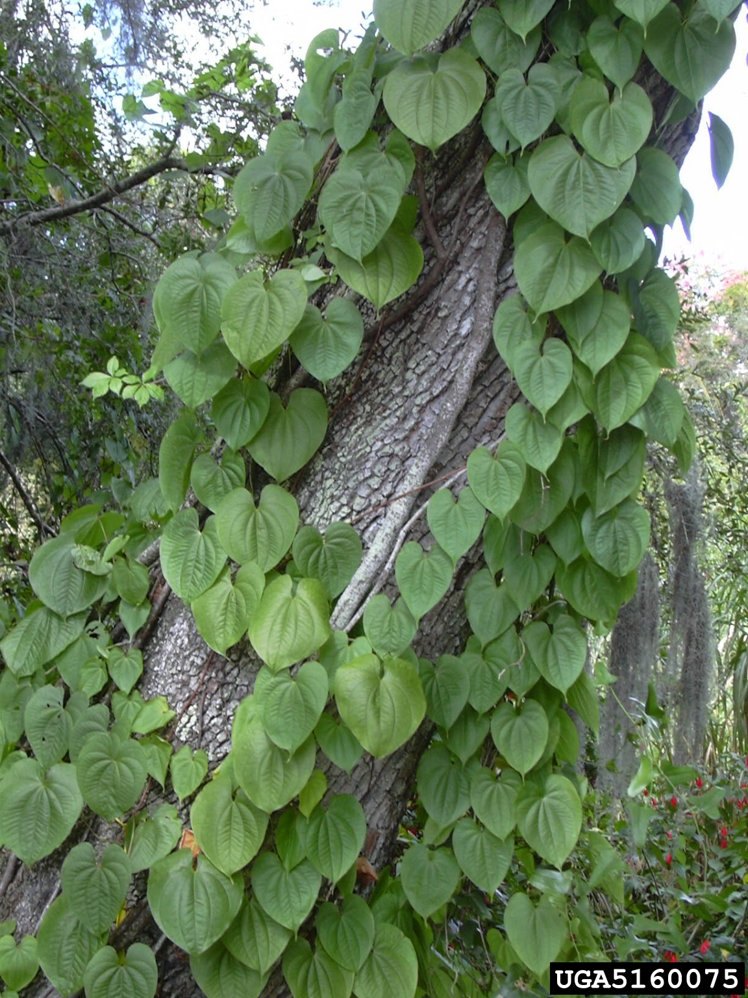
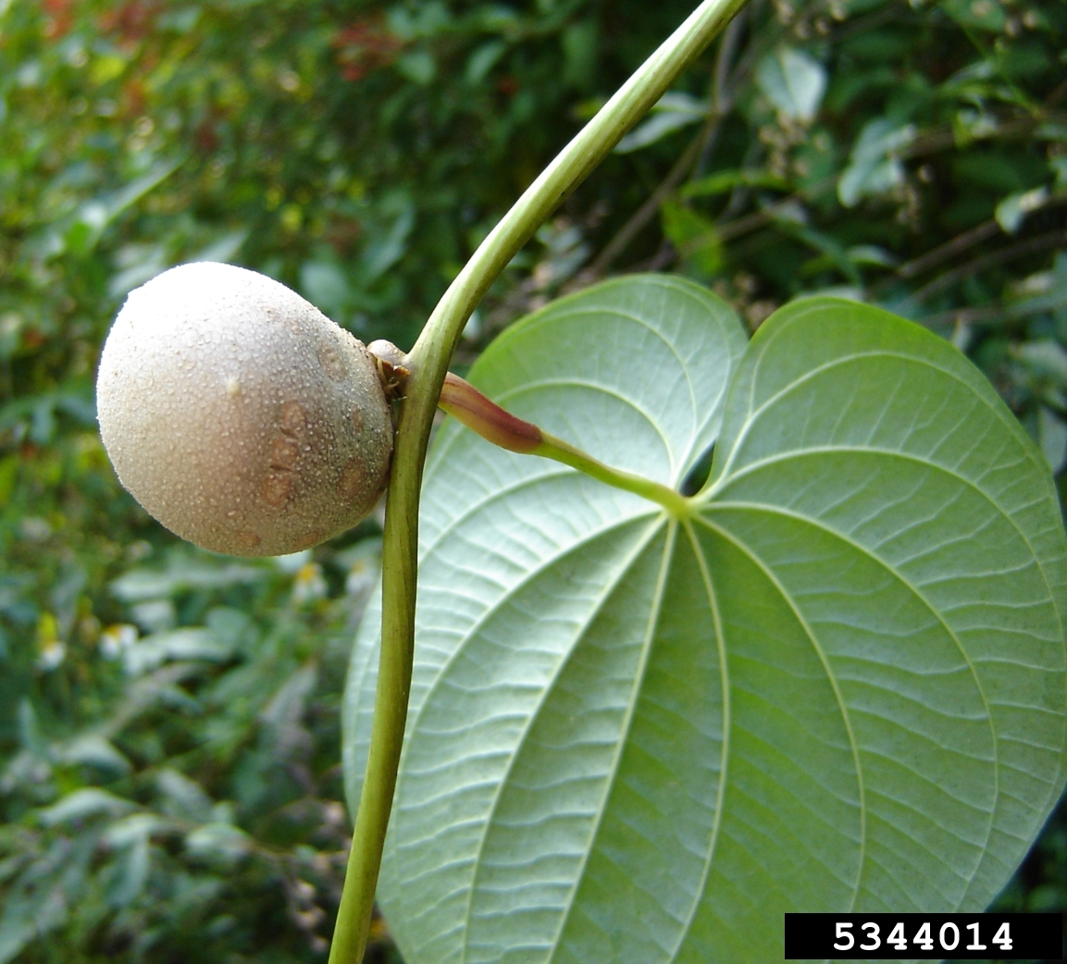
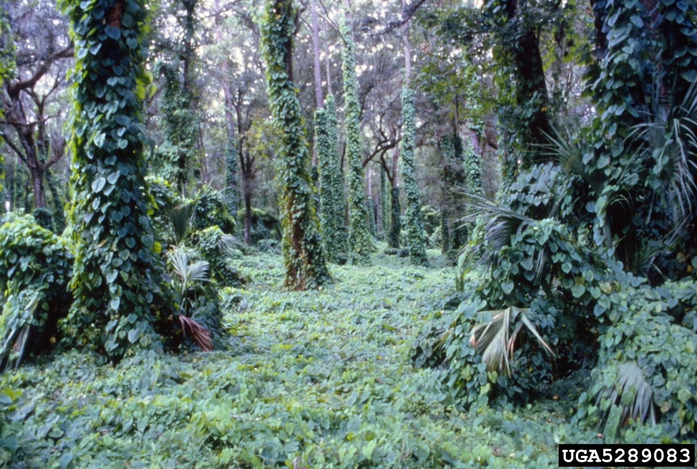
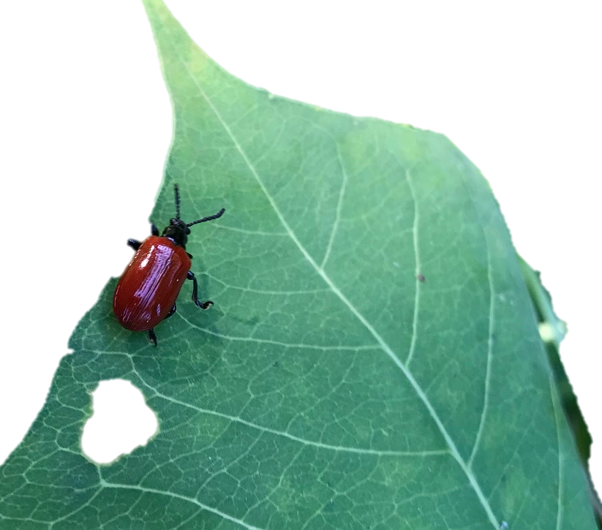
Air Potato Dioscorea bulbifera
Native: Climbing herbaceous vine from Asia
Introduction: Brought to Florida in 1905.
Spread though Southeast US including Texas
Identification: Large leaves (8 in.) are heart-shaped. Vines have no thorns. Produces large potato-like tubers (up to 6 in.).
Harm: Dense mats smother shrubs, the ground and trees; grows 8in./day - up to 80 ft. long!
Intensifies fires because their climbing nature carries the fire up into the tree canopy.
Disrupts waterflow when overtake riparian areas.
Management: Mechanical & Chemical treatments.
Physically pull down the vines
Bag up all parts for disposal
Spray the vines with foliar spray
REPEAT REPEAT REPEAT!
Biocontrols: Air Potato Leaf Beetle release in Texas, and attack Tallow too!
Notes:
PHOTO CREDITS:
Air Potato: Karen Brown, University of Florida, Bugwood.org
Air Potato (leaves):Forest and Kim Starr, Starr Environmental, Bugwood.org
Air potato (smother): FL Division of Plant Industry , FL Dept of Ag and Consumer Services, Bugwood.org
Air Potato Leaf Beetle: The Woodlands Township Invasive Species Program.
FACT SHEETS to share:
Air Potato: https://edis.ifas.ufl.edu/pdf/AG/AG112/AG112-D4b9tm91f2.pdf AND https://edis.ifas.ufl.edu/pdf/IN/IN972/IN972- Djjek8iju0.pdf (2nd is about biocontrol Air Potato Leaf Beetle)

Slide 13
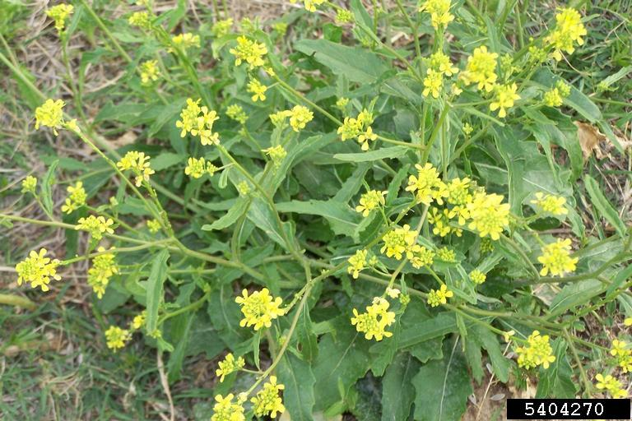
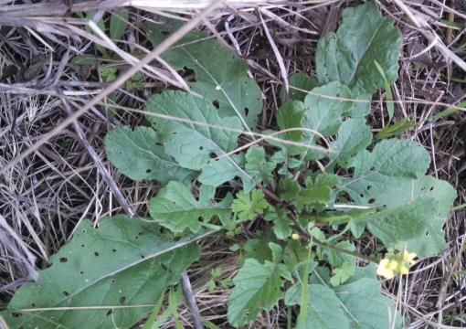
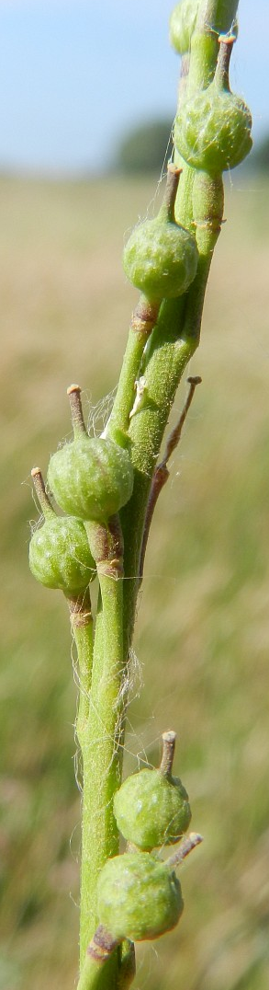
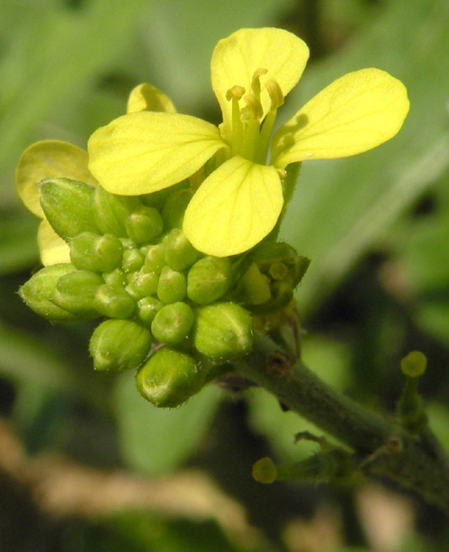
Bastard cabbage (aka Turnipweed) Rapistrum rugosum
Native: Southern Europe, north Africa and western Asia, annual plant that can grow up to 5 ft. tall.
Introduction: Uncertain but thought to be a seed contaminate in grass mixtures.
Now: Occurs in 16 states including Texas.
Identification: Leaves are lobed and wrinkled. Will appear as rosettes when first establishing.
Yellow flower clusters appear in spring.
Fruits are unique in appearance by being in a two-segmented seed capsule.
Harm: Develops a large mass of basal leaves, which allows it to successfully outcompete native plant species, and form monocultures.
Established in agricultural fields, roadsides, and disturbed lands and is becoming invasive in natural areas.
Management:
Mowing will remove some flowers and reduce seed stocks. A preferred method is to remove the whole plant including the taproot.
Chemical control may be difficult because it can become resistant to several herbicides.
Notes:
PHOTO CREDITS:
Bastardcabbage: Karan A. Rawlins, University of Georgia, Bugwood.org
Bastard cabbage (rosette): Citizen Report to Texasinvasives.org
Bastardcabbage (flower): Emma Silviana Mauri, Flora Italiae
Bastard cabbage (seeds): freenatureimages.eu
FACT SHEETS TO SHARE:
Bastard Cabbage: https://www.invasive.org/alien/fact/pdf/raru1.pdf

Slide 14
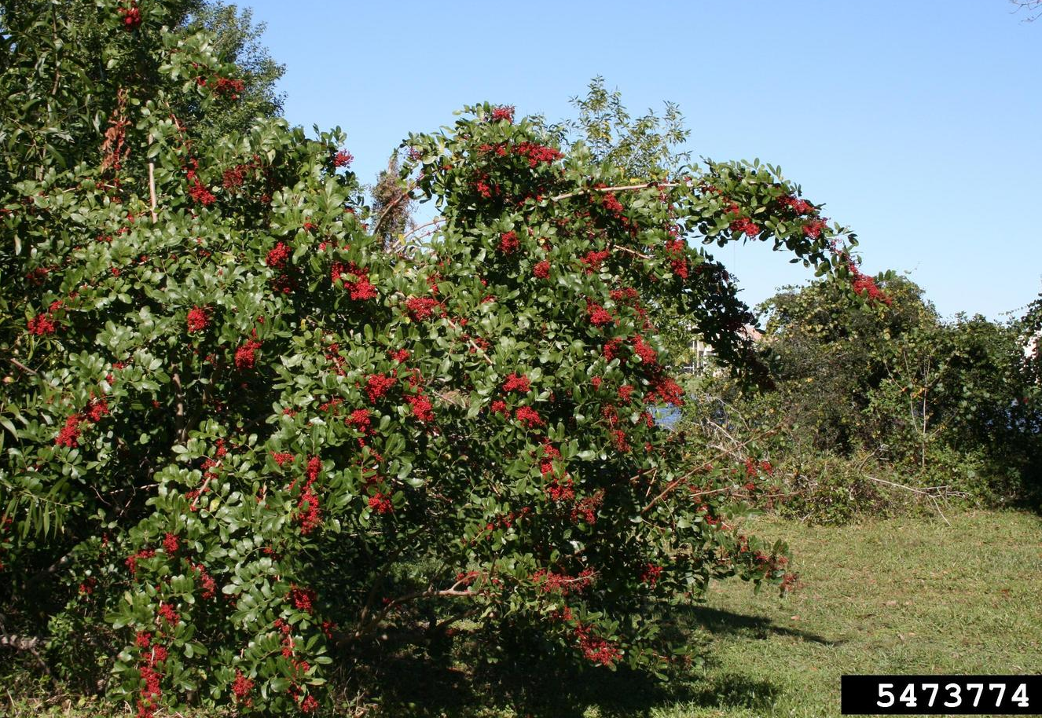
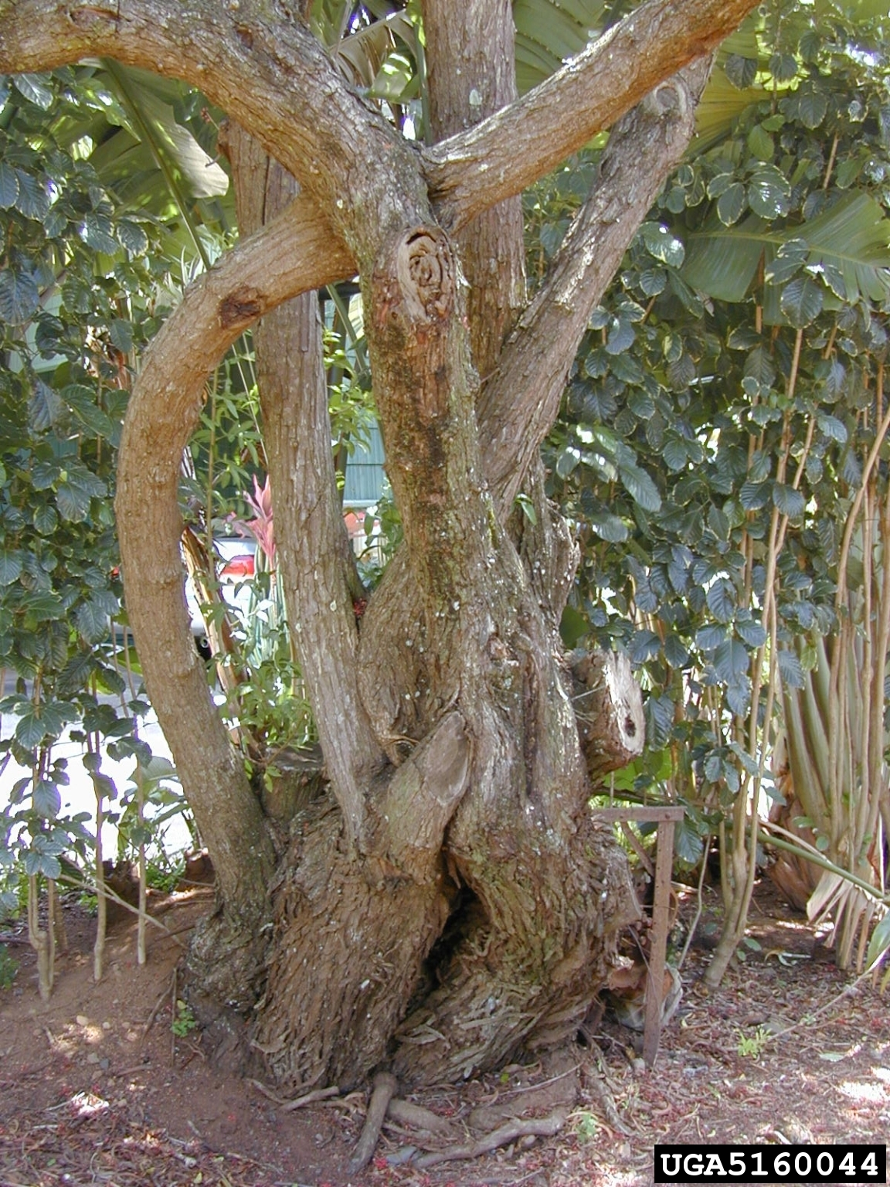
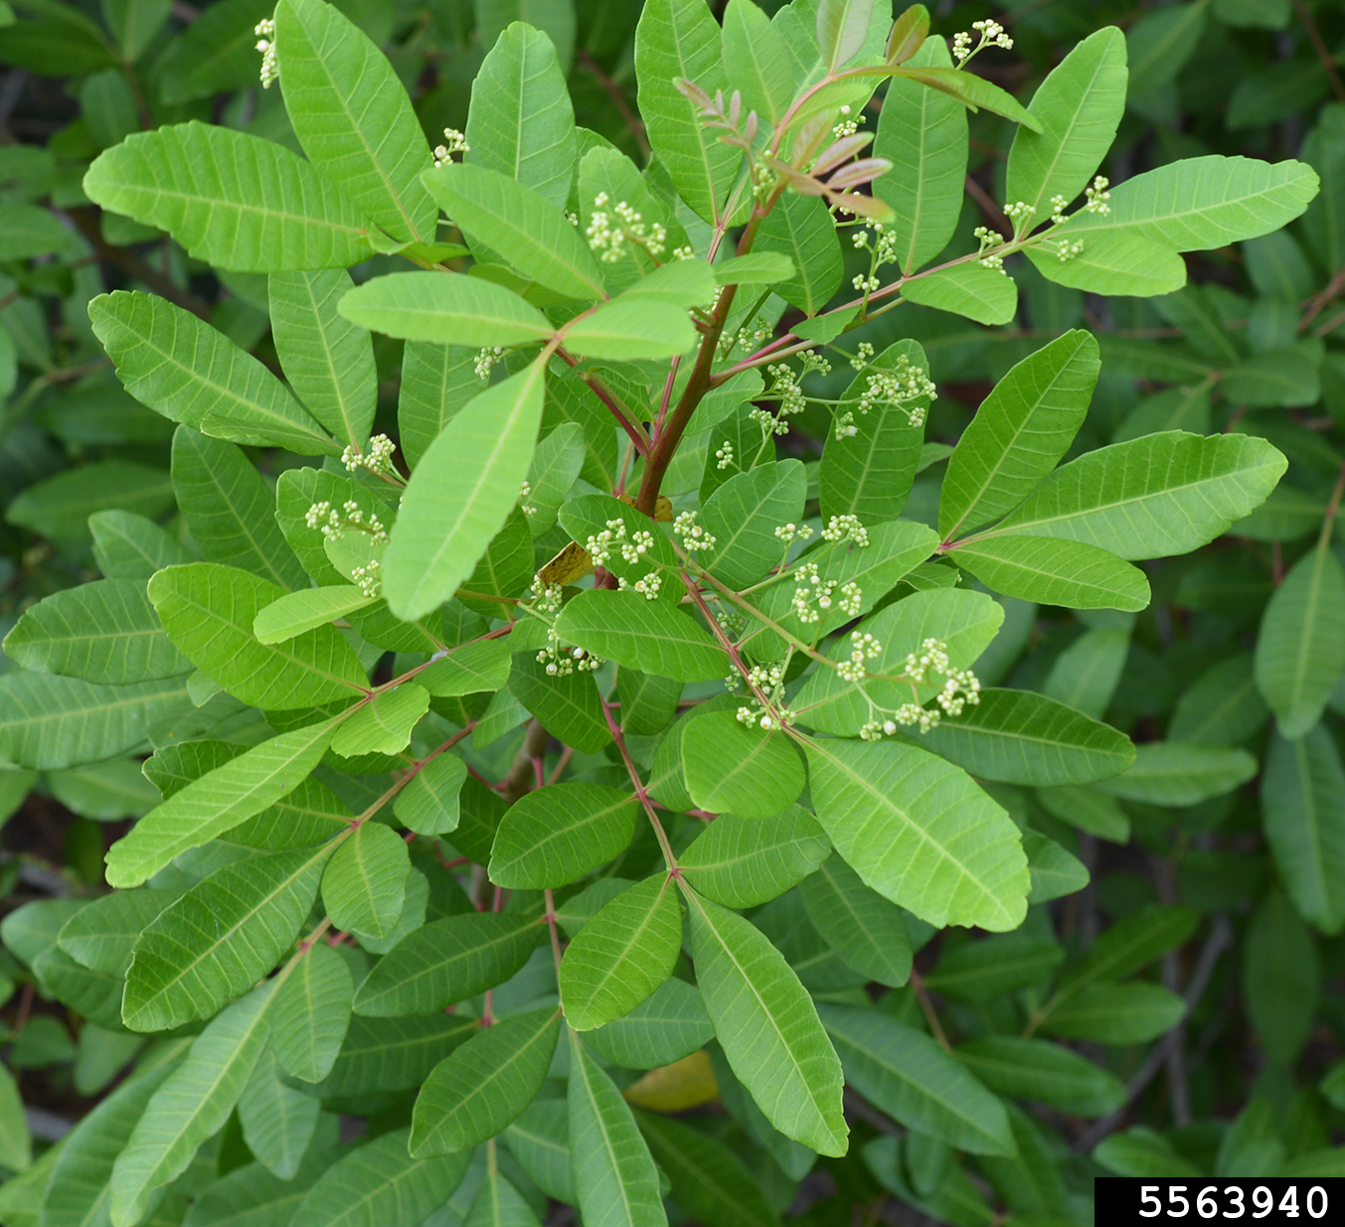
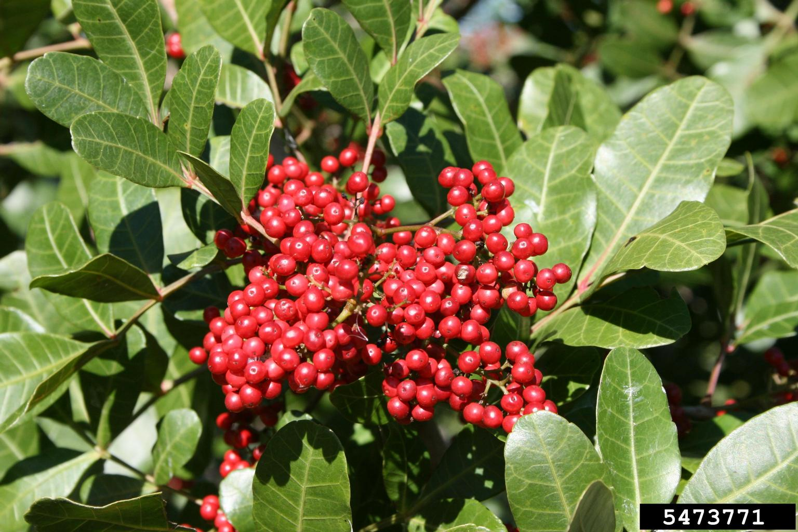
Brazilian Peppertree Schinus terebinthifolius
Native: Brazil, grows to 40 ft tall as shrub or tree.
Introduction: Brought as an ornamental to Florida in 1800s.
Now: Widespread in Texas but is prohibited to sell!
Identification: Leaves are pinnately compound with 3-13 leaflets.
White-petaled flowers cluster in small groups
Produces hundreds of bright-red berry clusters.
Creates several tree trunks in winding patterns.
Harm: Considered one of the greatest threats to native biodiversity for its dramatic affect on both plant and animal communities. Forms dense thickets, shading out native grasses, shrubs, and taking over native pine forests.
Management: Mechanical & Chemical treatments
Hand-pull small sprouts as quickly as possible!
Root fragments will cause resprouting.
Cut tree & quickly apply herbicides to stumps
REPEAT REPEAT REPEAT!
Notes:
PHOTO CREDITS:
Brazilian Peppertree: Stephanie Sanchez, Bugwood.org
Brazilian Peppertree (flower buds): Shaun Winterton, USDA APHIS PPQ, Bugwood.org
Brazilian Peppertree (berries): Stephanie Sanchez, Bugwood.org
Brazilian Peppertree (winding trunks): Forest and Kim Starr, Starr Environmental, Bugwood.org
FACT SHEETS to share:
Brazilian Peppertree: https://edis.ifas.ufl.edu/pdf%5CAA%5CAA219%5CAA219-D6hqvlge3m.pdf

Slide 15
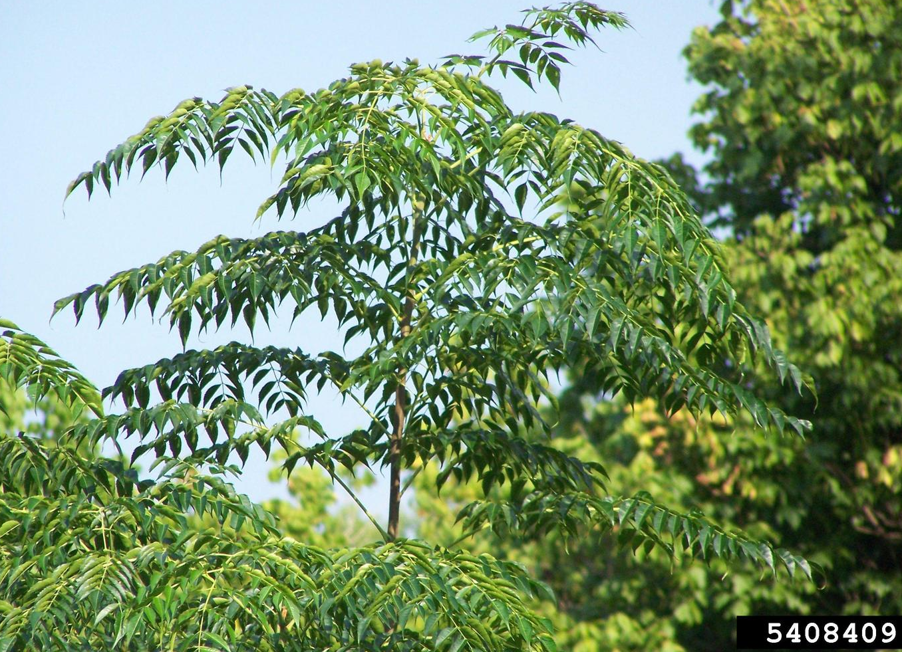
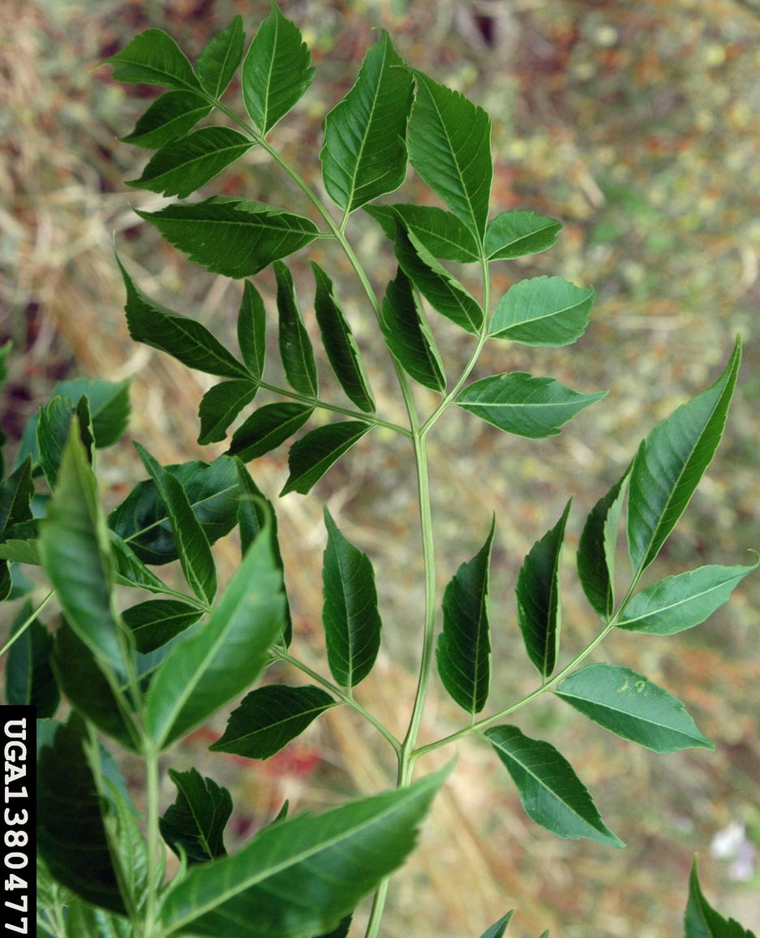
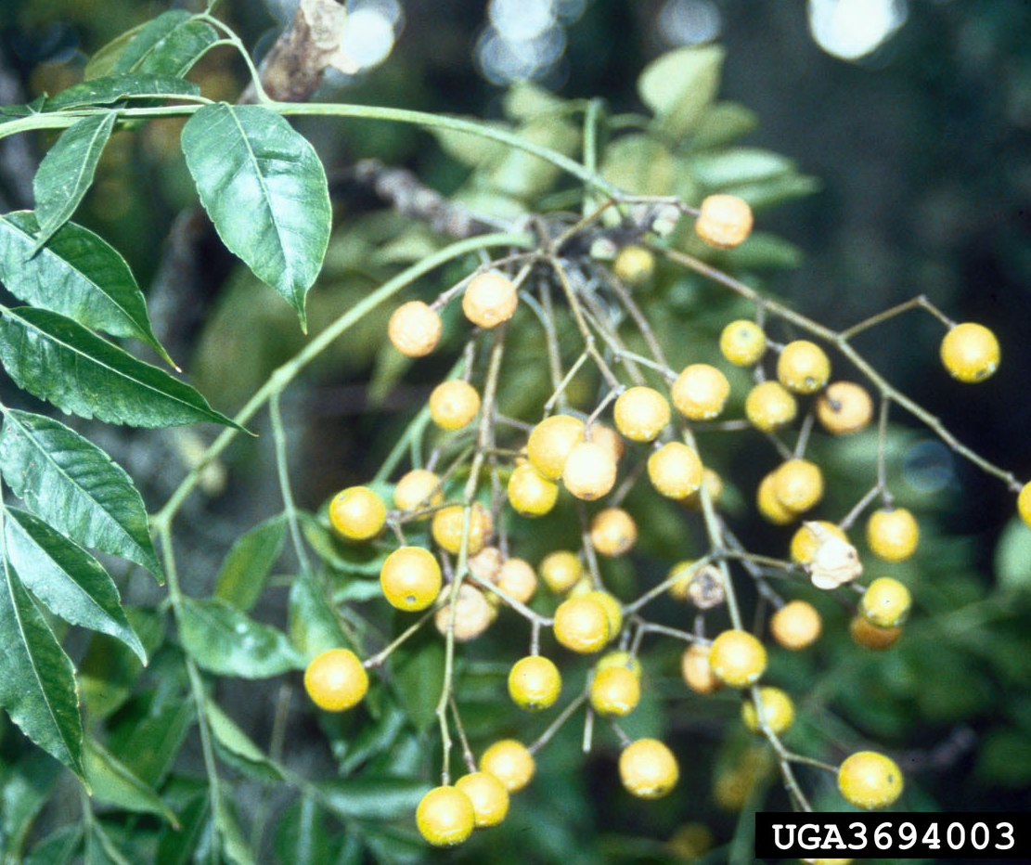
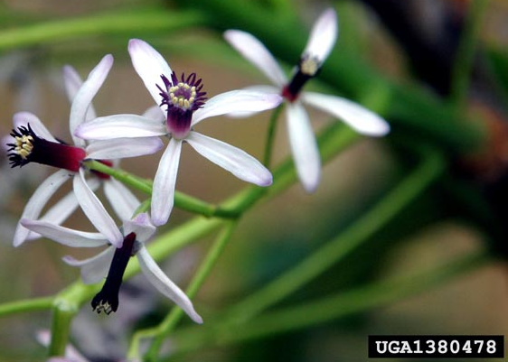
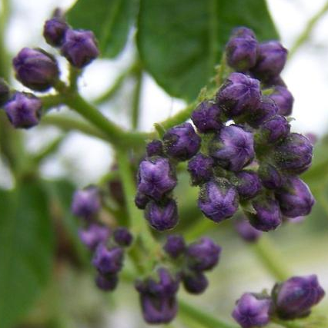
Chinaberry Tree Melia azedarach
Native: China, grows up to 70 ft tall.
Introduction: Imported as a shade tree in southern states in mid-1800s.
Now: Present in over 20 states. Widespread in Texas
Identification: Leaves are bi-pinnately compound, 1-2 ft in length and turn yellow in the fall.
In spring, lavender buds become 5-petaled flowers.
Produces hundreds of yellow, marble-sized berries.
Harm: Outcompetes native plants with seed production, and secreting chemicals for Chinaberry benefit and growth.
Flowers serve no pollinator benefit, and seeds are widely spread by birds.
ALL parts of the plant, especially the fruit are poisonous to humans, some livestock, and mammals (like cats & dogs).
Management: Mechanical & Chemical treatments
Cut tree & quickly apply herbicides to tree stump
REPEAT REPEAT REPEAT!
Notes:
PHOTO CREDITS:
Chinaberry: Karan A. Rawlins, Univ of Georgia, Bugwood.org
Chinaberry (leaves): Chris Evans, Univ. of Illinois, Bugwood.org
Chinaberry (buds): Karan Rawlins, Univ. of Georgia
Chinaberry (flowers): Chris Evans, Univ. of Illinois, Bugwood.org
Chinaberry (w/ yellow seeds): Cheryl McCormick, University of Florida, Bugwood.org
FACT SHEETS to share:
Chinaberry: https://www.invasive.org/alien/fact/meaz1.htm

Slide 16
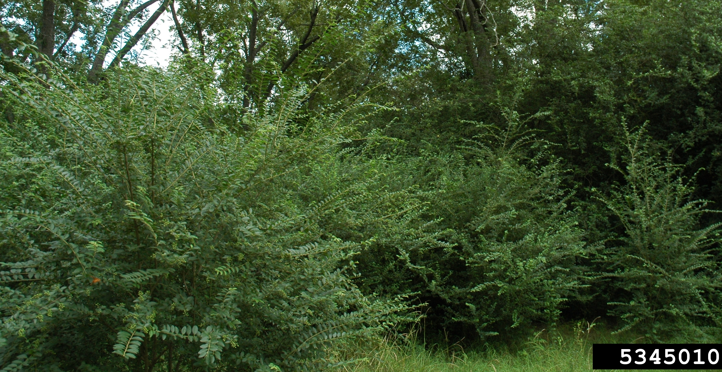
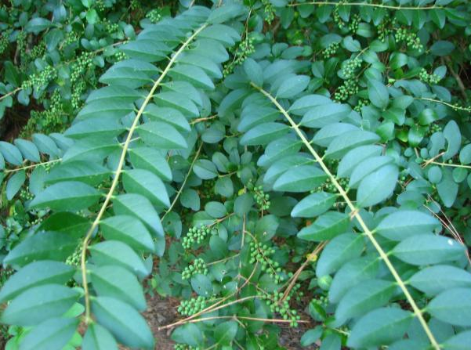
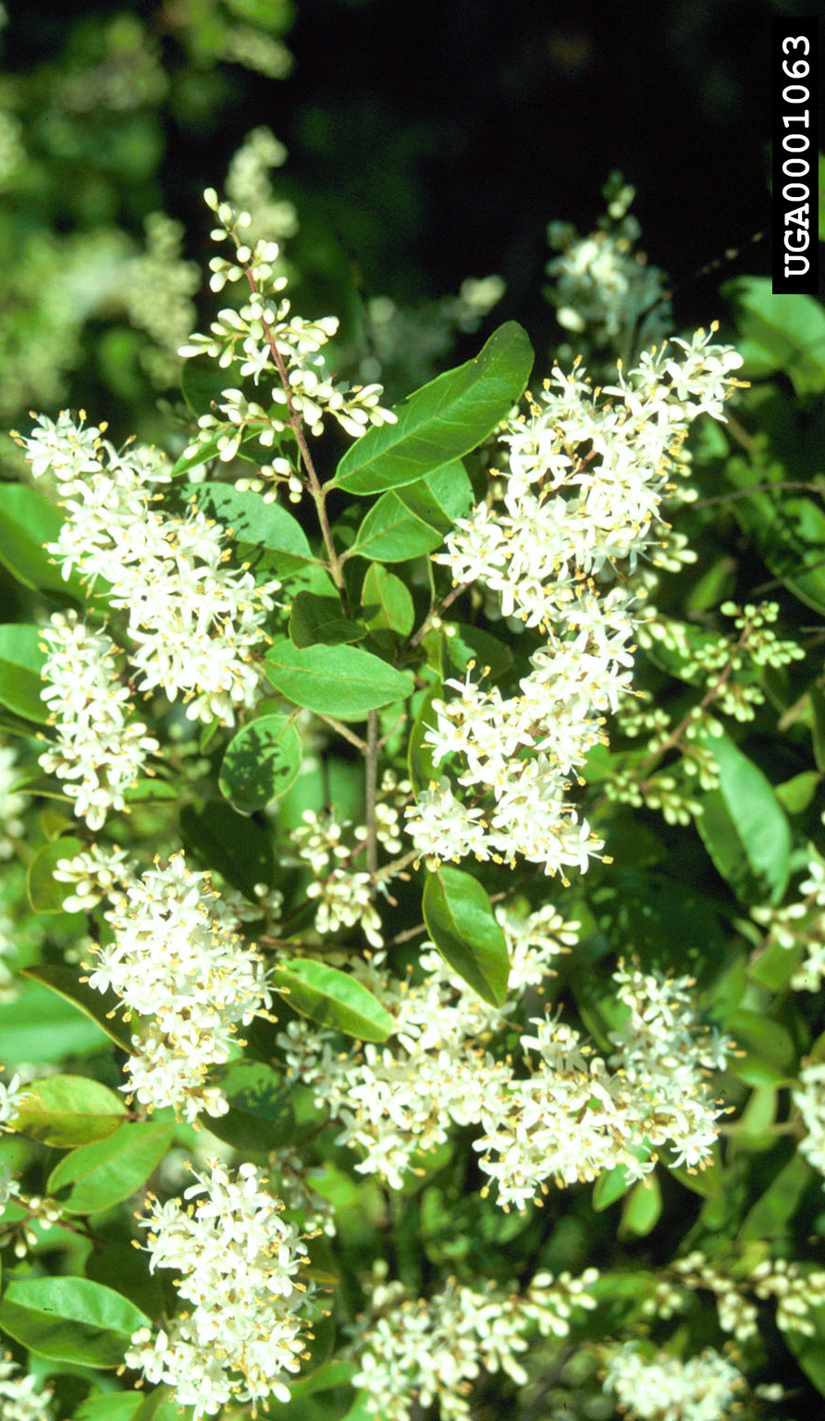
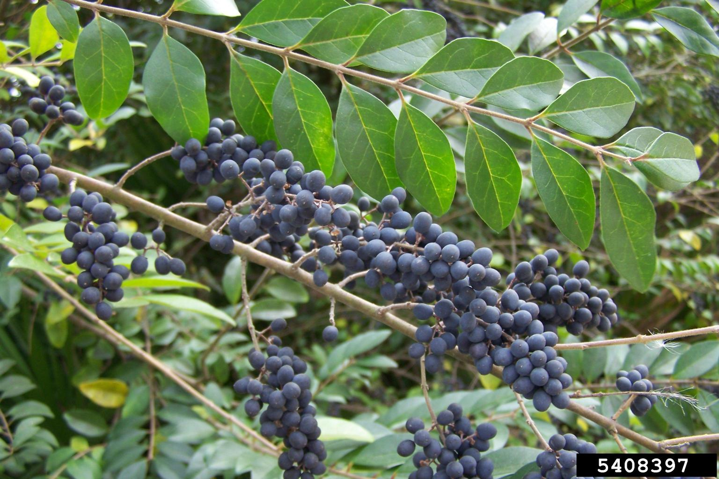
Chinese Privet Ligustrum sinense
Native: China, grows to 40 ft tall as shrub or tree.
Introduction: Brought as an ornamental in 1852.
First Spread: Escaped cultivation (Louisiana, 1930s). Widespread in Texas & still available for purchase!
Identification: Leaves are oblong (1-3 in.), on branches extending several feet in length.
Numerous white and fragrant flower clusters.
Produces hundreds of blue-black berry clusters.
Harm: Outcompetes native plants with seed production and root sprouts. It will dominate pastures and natural areas.
Berries are poisonous to humans.
Management: Mechanical & Chemical treatments
Hand-pull small sprouts as quickly as possible!
Root fragments will cause resprouting.
Cut tree & quickly apply herbicides to stumps
REPEAT REPEAT REPEAT!
Notes:
PHOTO CREDITS:
Privet (Shrubs): David J. Moorhead, University of Georgia, Bugwood.org
Privet (leaves): Citizen Report to Texasinvasives.org
Chinese Privet (berries): Karan A. Rawlins, University of Georgia, Bugwood.org
Privet (flowers): James R. Allison, Georgia Dept of Natural Resources, Bugwood.org
FACT SHEETS to share:
Chinese Privet: https://extension.tennessee.edu/publications/Documents/W324.pdf

Slide 17
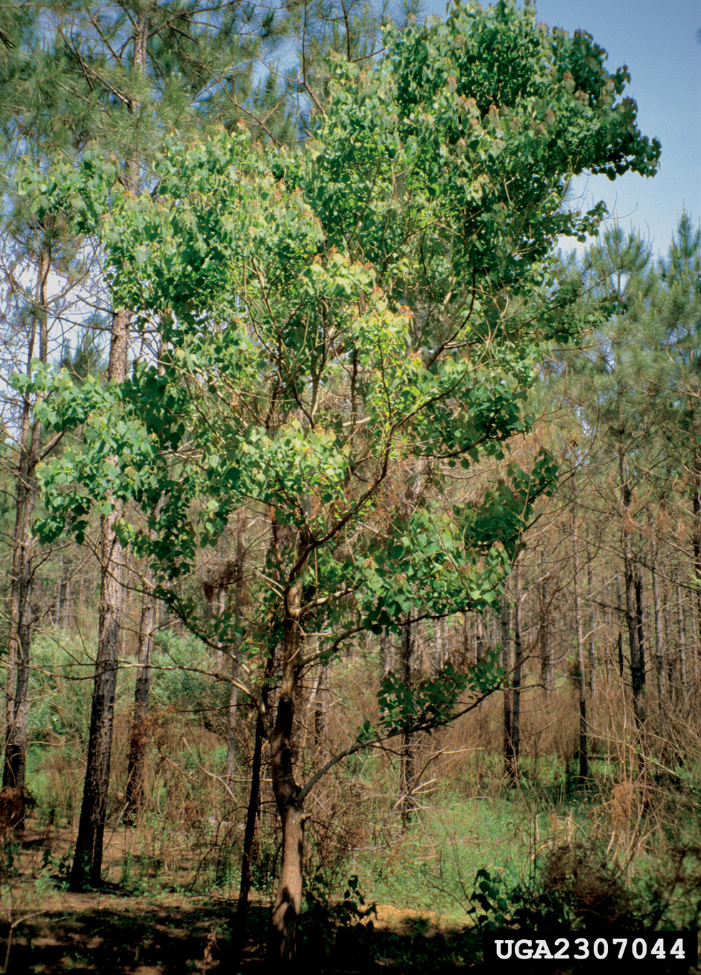
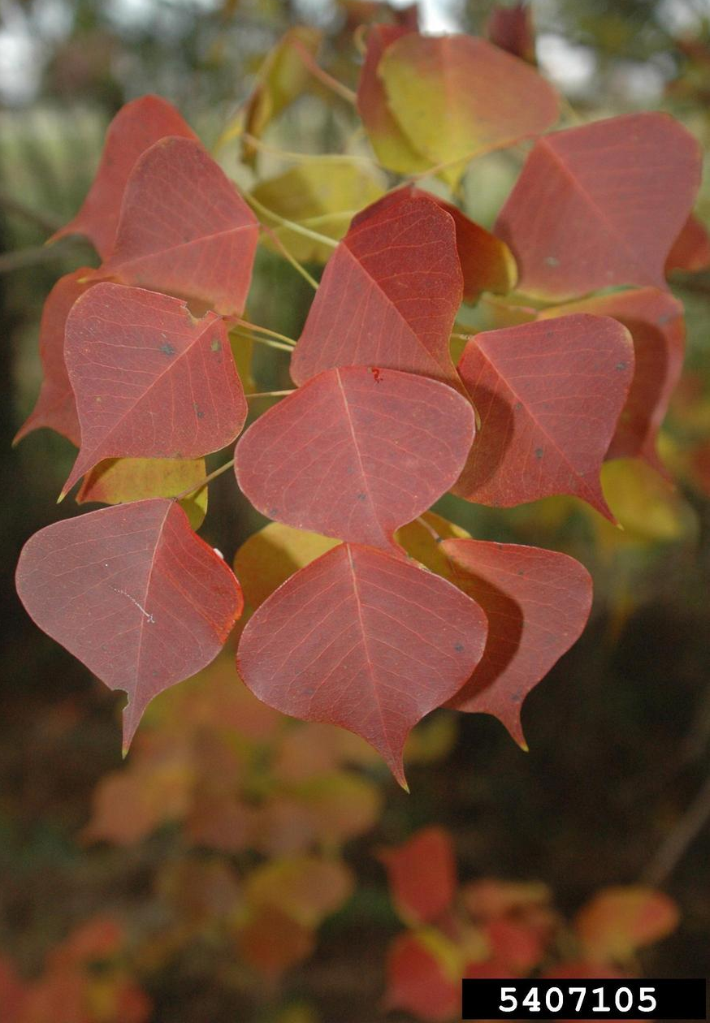
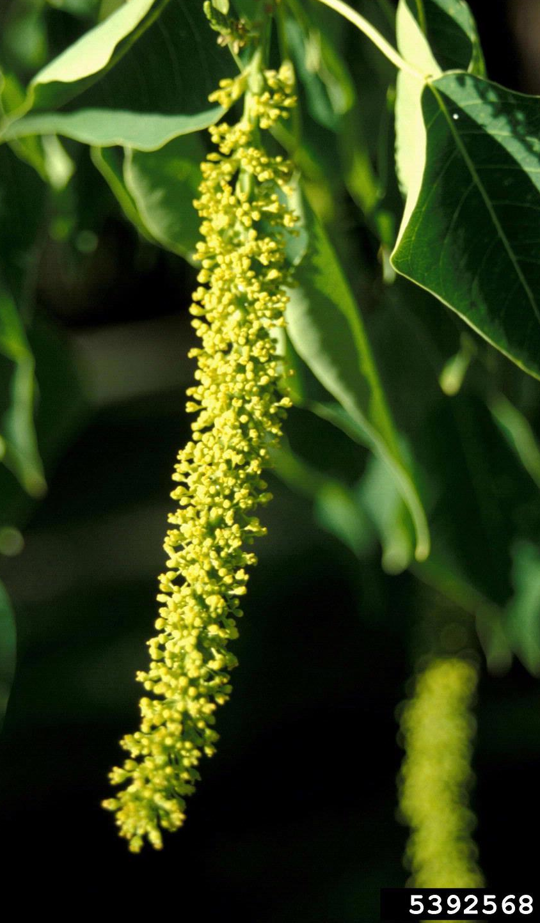
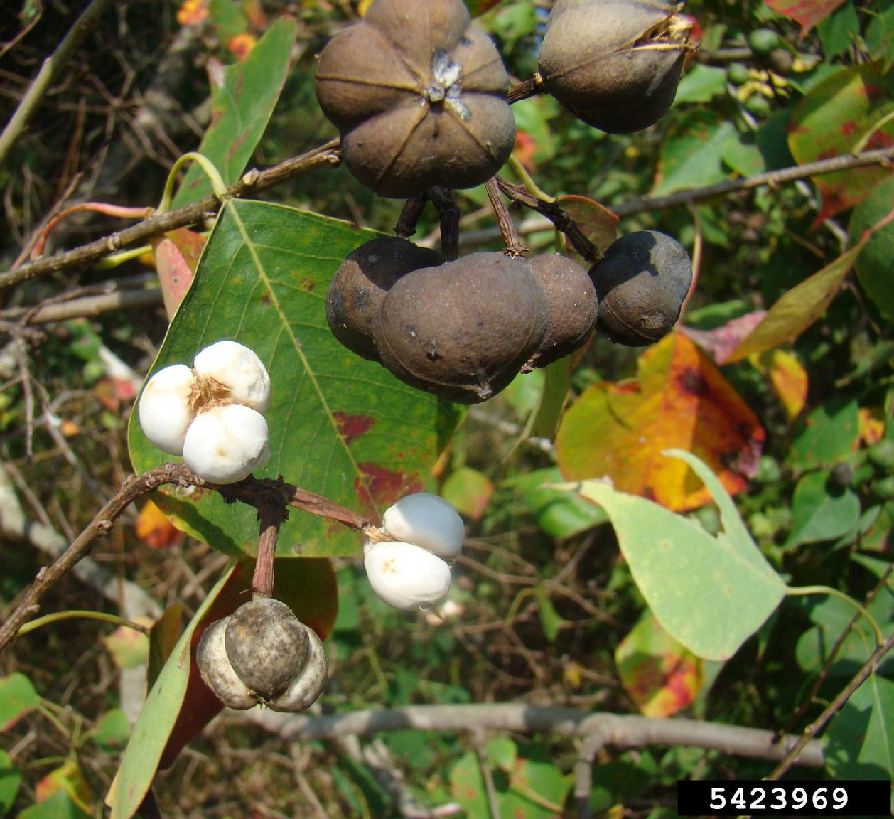
Chinese Tallowtree Triadica sebifera
Native: China and can growth up to 70 ft tall.
Introduction: Imported for ornamental, soap and seed oil production in the 1700s
Now: Widespread Southeast US and Texas
Identification: Leaves are rounded and kite-shaped, that change colors in the fall.
Flowers develop into catkins
Then a three-lobed capsule with white waxy seeds insides (like popcorn).
Harm: Produces thousands of seeds that can be dormant in the soil for 5 years; making it difficult to eliminate.
Seeds have tannins that acidifies soil pH and inhibits native plants but benefits Tallow growth. They also change water pH when enough fall into water source.
Management: Mechanical & Chemical treatments
Hand-pull small sprouts as quickly as possible!
Cut tree & quickly apply herbicides to stumps
REPEAT REPEAT REPEAT!
Notes:
PHOTO CREDITS:
Chinese Tallow: James H Miller, USDA Forest Service, Bugwood.org
Chinese Tallow (changing leaves): Karan A. Rawlins, University of Georgia, Bugwood.org
Tallow (catkins): John M. Randall, The Nature Conservancy, Bugwood.org
Chinese Tallow (seeds): Franklin Bonner, USFS (retired), Bugwood.org
FACT SHEETS to share:
Chinese Tallow: https://extension.msstate.edu/publications/chinese-tallowtree

Slide 18
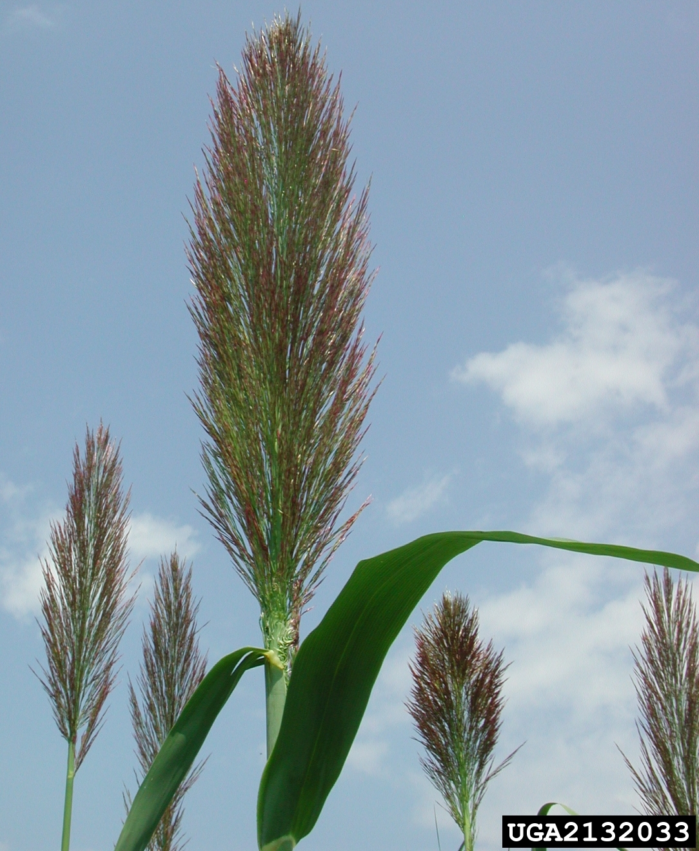
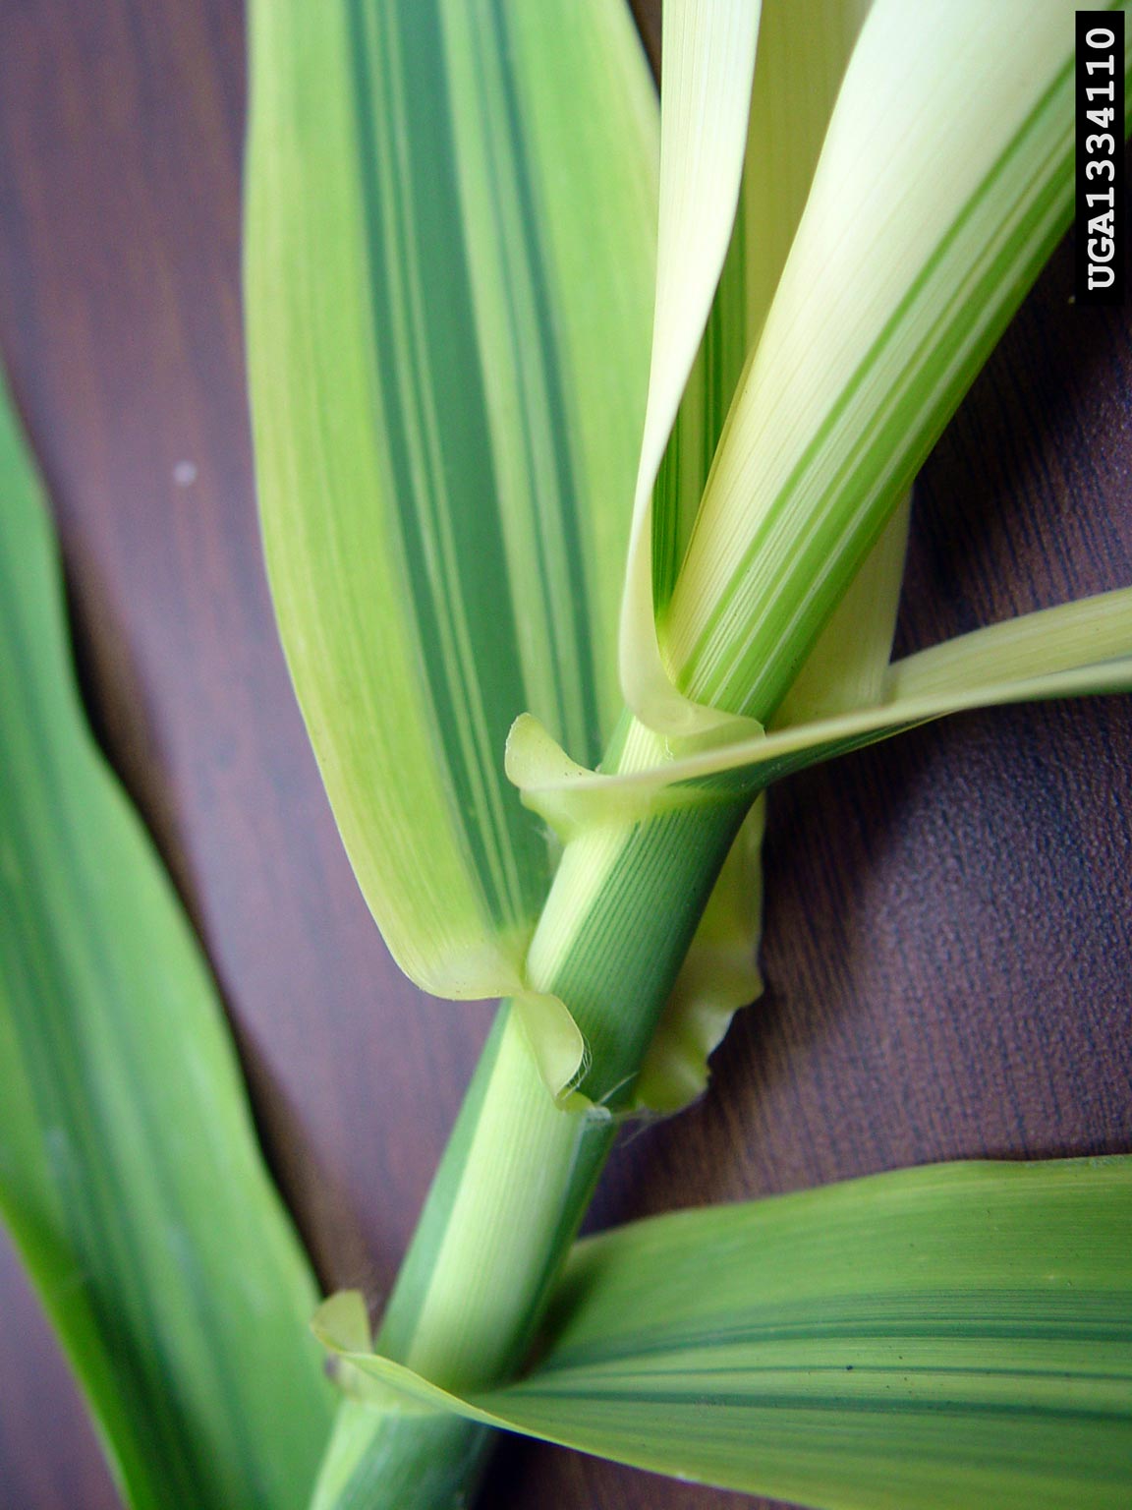
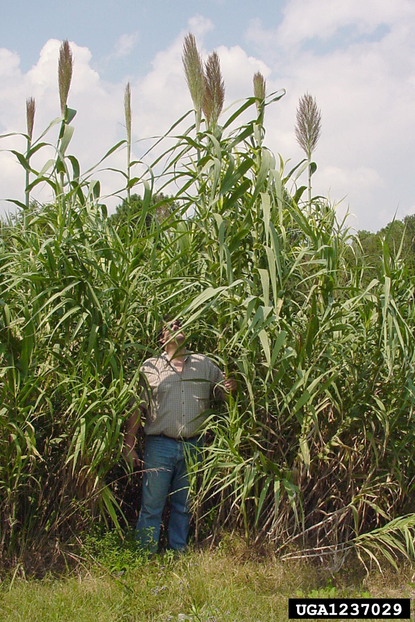
Giant Reed Arundo donax
Native: Perennial grass native to Eurasia that grows up to 20 ft tall.
Introduction: In the early 1800s to California.
Now: Found in 25 states. Widespread in Texas
Identification: Leaves are a foot long. Flowers present as 2 ft. plumes during August & September.
Establishes in ditches, streams and riverbanks.
Harm: Chokes riversides and stream channels, crowds out native plants, interferes with flood control, increases fire potential, and reduces habitat for wildlife
Root and stem fragments can float miles downstream and start new infestations.
Management: Mechanical & Chemical treatments.
Mechanical removal alone can leave behind segments that reproduce.
Apply herbicides after flowering period either with “Cut Stump” or “Foliar” treatment. Prescribed fires also help.
REPEAT REPEAT REPEAT!
Notes:
PHOTO CREDITS:
Giant Reed: Chuck Bargeron, University of Georgia, Bugwood.org
Giant Reed (leaf connections): Chris Evans, University of Illinois, Bugwood.org
Plume of Giant Reed: David J. Moorhead, University of Georgia, Bugwood.org
FACT SHEETS to share:
Giant Reed: https://www.invasive.org/alien/fact/pdf/ardo1.pdf

Slide 19
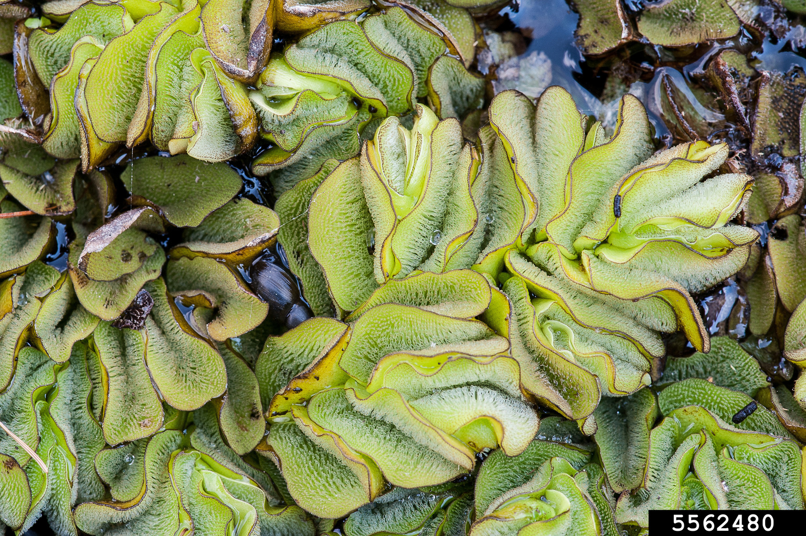
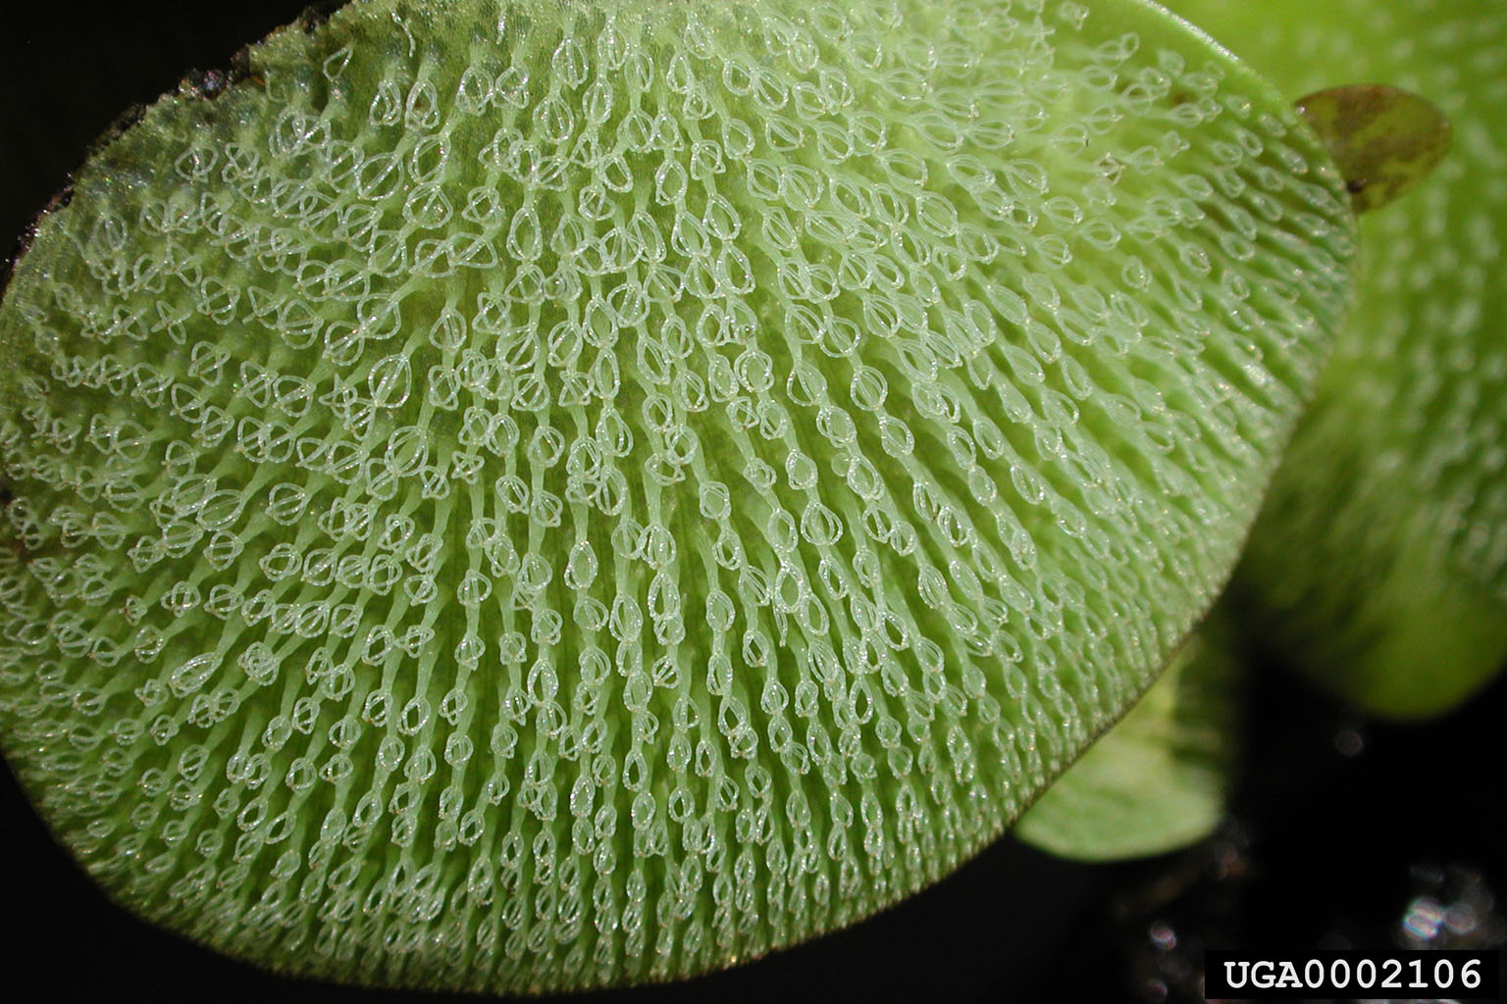
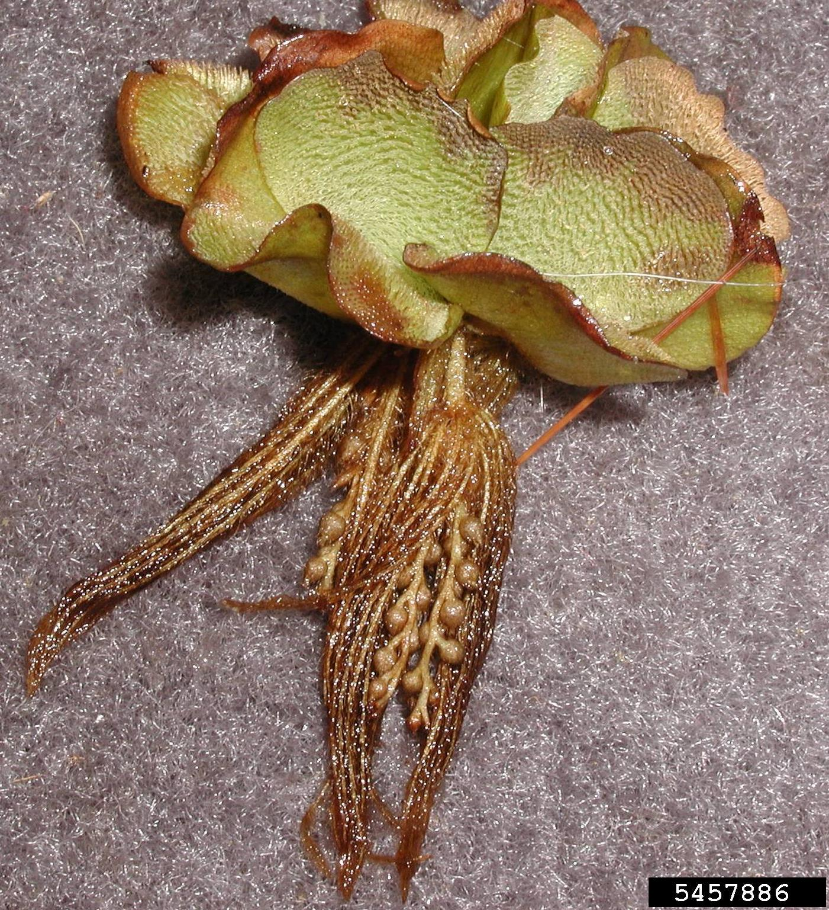
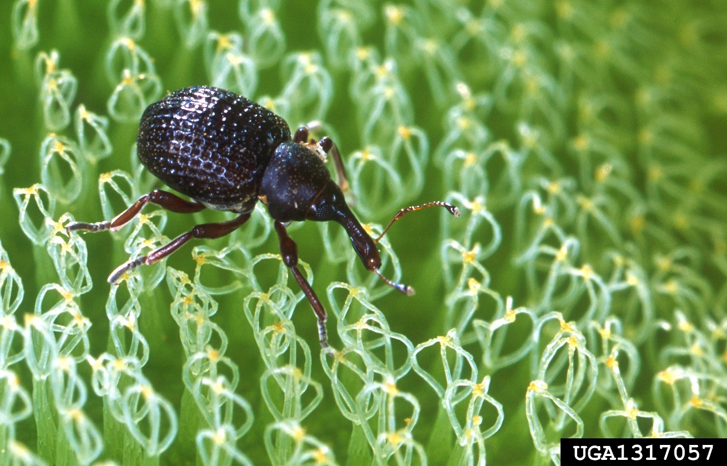
Giant Salvinia Salvinia molesta
Native: Free-floating aquatic fern native to Brazil.
Introduction: Intentionally as an aquarium and water garden plant, and unintentionally as a contaminant in shipments of other aquatic plants.
First Detection: South Carolina in 1995. Widespread in Texas
Identification: Two oblong leaves above the water surface, they have “egg-beater” leaf hairs on
Underwater there is one leaf that acts as root-like structures.
The entire plant about 1-2 inch in depth.
Harm: Grows on the surface of water. It will fully cover water surface, blocking sunlight penetration, causing oxygen depletion, and even fish kills.
Management: Clean, Drain, Dry your boats and equipment!!
Biocontrols: Salvinia Leaf Weevil is being distributed by TPWD.
www.aphis.usda.gov & www.texasinvasives.org
Notes:
PHOTO CREDITS:
Giant Salvinia: Keith Bradley, Conservation Botanist, Bugwood.org
Giant Salvinia: Mic Julien, Commonwealth Scientific and Industrial Research, Bugwood.org
Giant Salvinia (whole plant): Leslie J. Mehrhoff, University of Connecticut, Bugwood.org
Salvinia Weevil: Scott Bauer, USDA Agricultural Research Service, Bugwood.org
FACT SHEETS to share:
Giant Salvinia: https://www.texasinvasives.org/giantsalvinia/

Slide 20
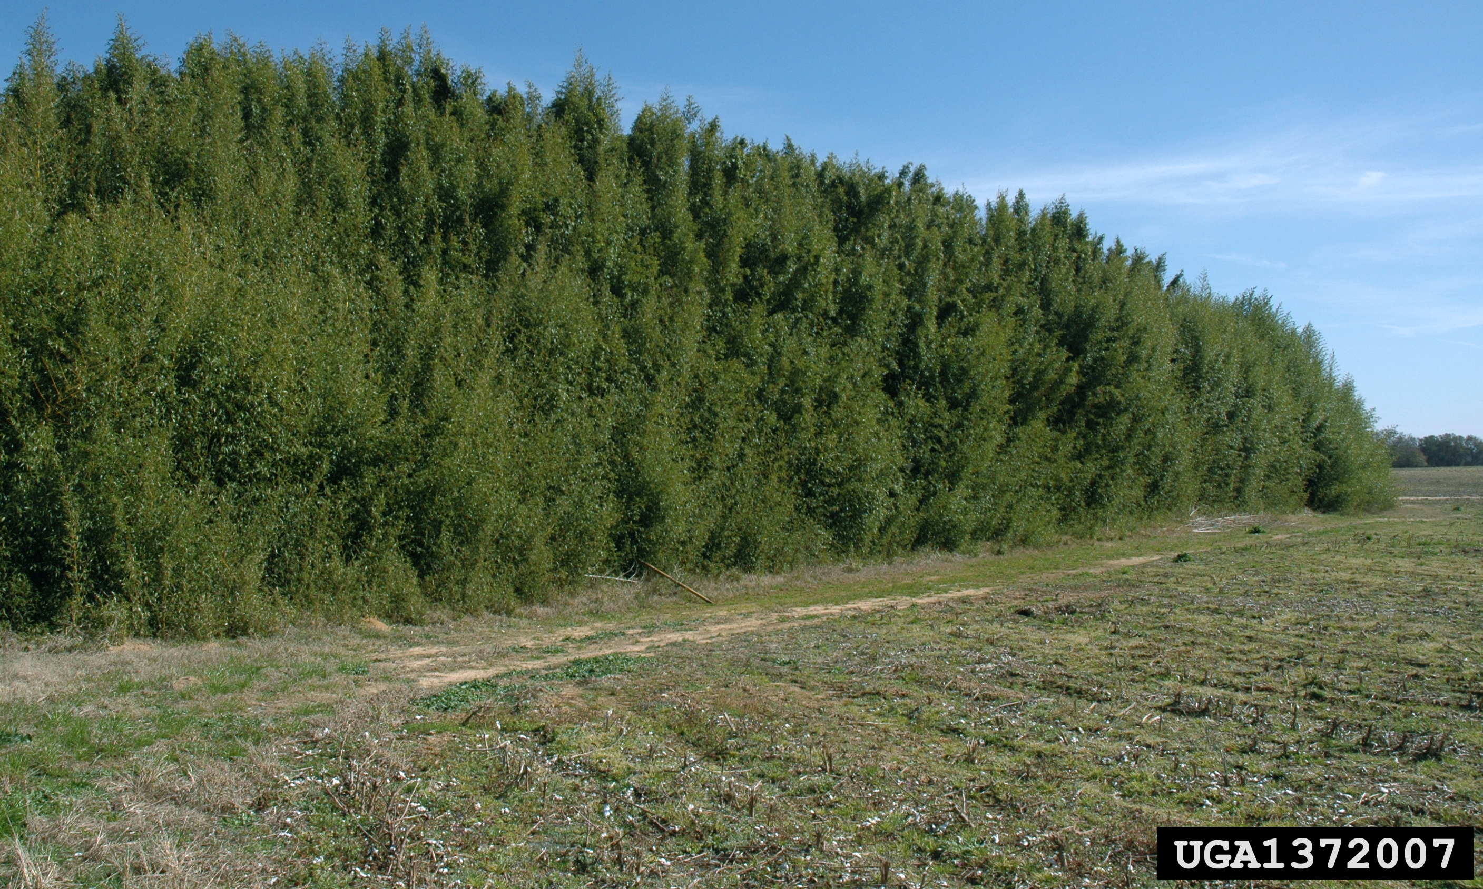
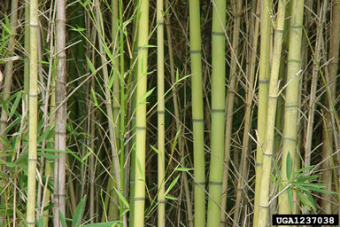
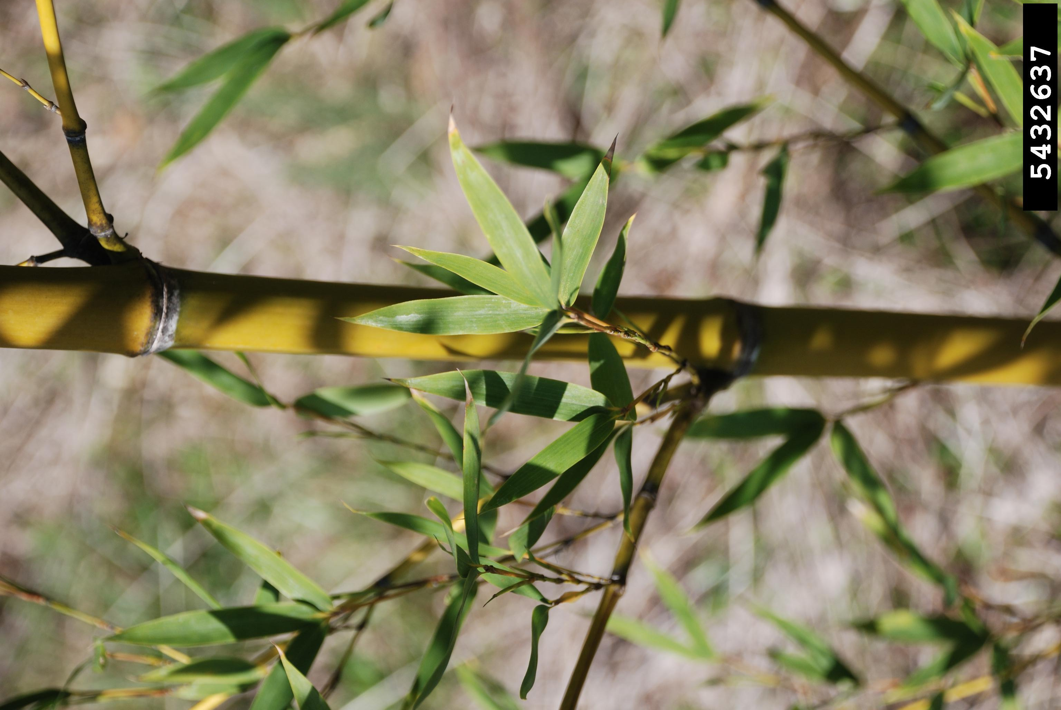
Golden Bamboo Phyllostachys aurea
Native: China & Japan, grows over 60 ft. tall.
Introduction: Brought to Alabama as an ornamental in 1882.
Now: Continues to be used as fence-line buffer. Widespread in Texas & still available for purchase!
Identification: Leaves are pointed and appear in fan-like clusters.
The jointed stem is called a culm and new leaves appear at the joints.
Harm: Rhizome roots allow it to grow rapidly and survive mechanical management. Quick growth allows it to outcompetes native plants and upset food chains.
For streams, bamboo leaf litter changes stream food webs including litter-feeding invertebrates necessary for balance.
It is also known to attract roaches in urban areas.
Management: Mechanical & Chemical treatments
Hand-pull small sprouts as quickly as possible!
Root fragments will cause resprouting.
Cut tree & quickly apply herbicides to stumps
REPEAT REPEAT REPEAT!
Notes:
PHOTO CREDITS:
Golden Bamboo: David J. Moorhead, University of Georgia, Bugwood.org
Bamboo leaves: Nancy Loewenstein, Auburn University, Bugwood.org
Bamboo stems: Chuck Bargeron, University of Georgia, Bugwood.org
FACT SHEETS to share:
Golden Bamboo: https://www.aces.edu/wp-content/uploads/2020/11/FOR-2088-Bamboo-Growth-and-Control_110520L-A.pdf

Slide 21
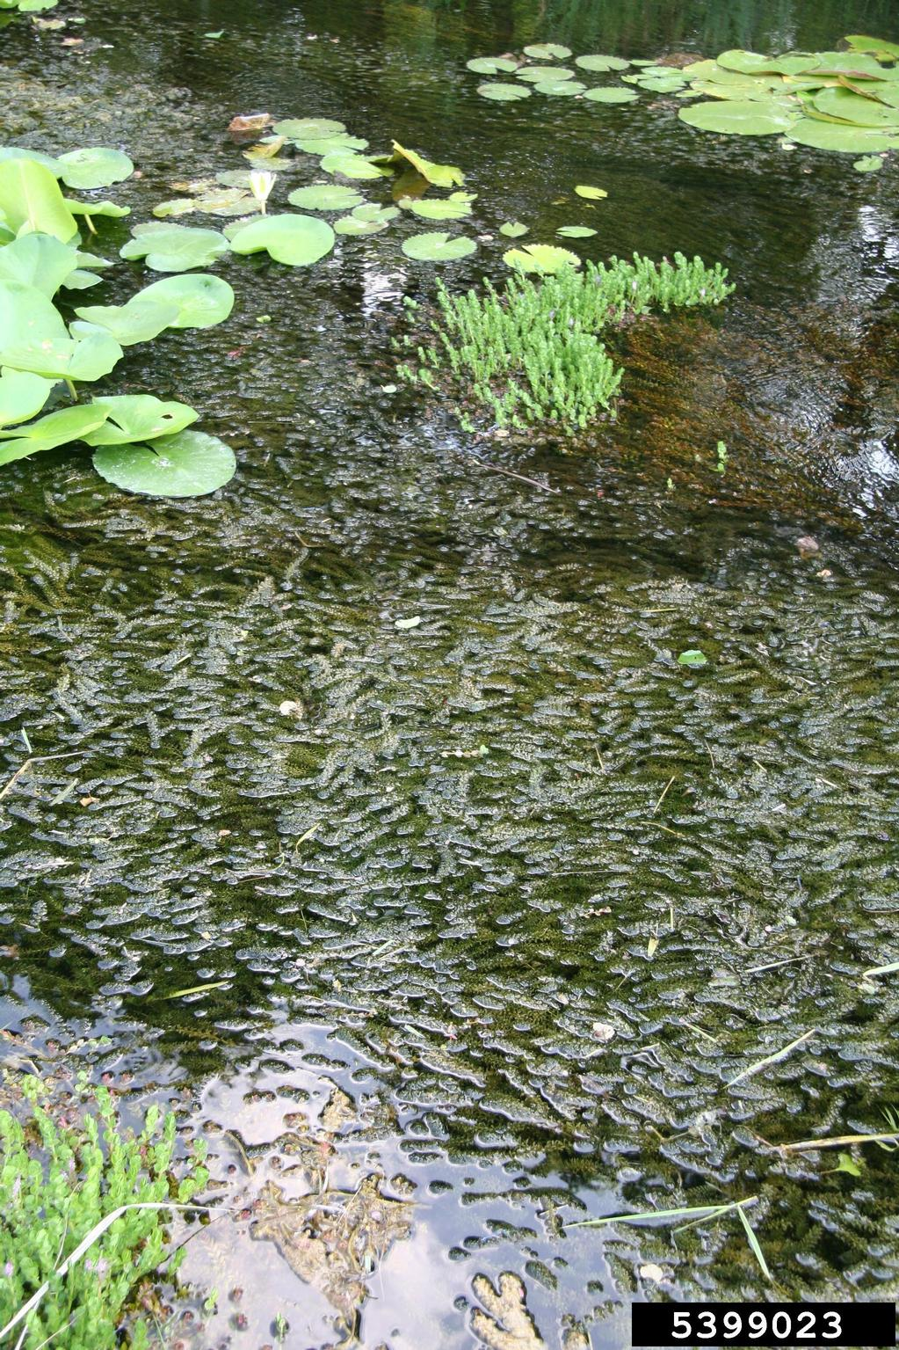
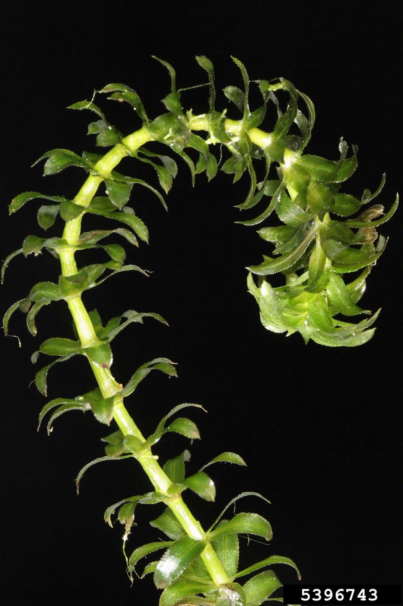


Hydrilla Hydrilla verticillata
Native: Rooted aquatic plant native Korea to India. One of the “World’s worst invasive aquatic plants”.
Introduction: Intentionally as aquarium and water garden plant in 1950s.
First Detection: Florida (1950s). Widespread in Texas
Identification: Long and slender plant with whorled leaves (usually 5). It has potato-like tubers attached to roots that help it spread.
Grows up to 25ft in length
At a rate of 1 ft/day!
Harm: Reproduces quickly and forms dense mats that block sunlight to underwater environment penetration, causing oxygen depletion, and even fish kills.
Reduces zooplankton and phytoplankton levels which changes the stability of the lake ecosystem.
Management: Clean, Drain and Dry your equipment!
Biocontrols: Triploid Grass Carps (sterile carps), and Leaf-mining flies.
www.aphis.usda.gov & www.texasinvasives.org
Notes:
PHOTO CREDITS:
Hydrilla (smothering pond): Robert Videcki, Doronicum Kft, Bugwood.org.
Hydrilla: Robert Videcki, Doronicum Kft, Bugwood.org.
Hydrilla (tubers): Leslie J. Mehrhoff, University of Connecticut and Robert Videcki, Doronicum Kft, Bugwood.org.
Triploid Grass Carp: USDA APHIS PPQ - Oxford, North Carolina ,Bugwood.org
FACT SHEETS to share:
Hydrilla: https://seagrant.psu.edu/sites/default/files/Hydrilla%202017.pdf

Slide 22




Japanese Climbing Fern Lygodium japonicum
Native: Terrestrial climbing fern from Japan.
Introduction: Intentionally brought as garden plant in 1888 to Florida. Still for sale on Internet!!
First Spread: Georgia (1903). Spreading in Texas
Identification: Leaves vary in appearance. New growth has finger-like fronds that have reproductive spores (no flowering!)
Harm: Rhizome systems allows it to grow dense mats that smother shrubs, the ground and trees.
Mats grow as thick as 10 feet & 90 feet long!
Intensifies fires because their climbing nature carries the fire up into the tree canopy.
Management: Mechanical & Chemical.
Physically pull down the vines
Bag up all parts for disposal
Spray the vines with foliar spray
REPEAT REPEAT REPEAT!
Reproductive fronds (spore-producing)
Notes:
PHOTO CREDITS:
Japanese Climbing Fern: Chris Evans, University of Illinois, Bugwood.org
Japanese Climbing Fern (vine climbing): Ronald F. Billings, Texas A&M Forest Service, Bugwood.org
Chris Evans, Illinois Wildlife Action Plan, Bugwood.org
Climbing Fern (fire out of control): Chuck Bargeron, University of Georgia, Bugwood.org
FACT SHEETS to share:
Japanese Climbing Fern: https://myfwc.com/media/3224/invasiveplants-japaneseclimbingfern.pdf

Slide 23


King Ranch Bluestem Bothriochloa ischaemum var. songarica
Native: Grass from Europe and North Africa.
Introduction: Intentionally brought to TX as cattle roughage, and then planted along highway roadsides. Now throughout southern U.S.
Identification: The grass “Flowers” are seed-head that look like a hand with purplish seeds throughout.
K R Bluestem will be the first growth to appear after hay has been cut.
Harm: Quickly grows and covers pastures, roadsides and Coastal Bermuda fields.
Outcompetes native Bluestems and can spread invasive insects that use it as a host plant.
Management: Mechanical & Chemical.
Herbicides alone are not effective
Pull up new growth as quickly as possible.
For older growth, dig out King Ranch Bluestem and then apply herbicides.
REPEAT REPEAT REPEAT!
Notes:
PHOTO CREDITS:
King Ranch Bluestem: Michelle Villafranca, Fort Worth Nature Center and Refuge, Bugwood.org
King Ranch Bluestem: Karan A. Rawlins, University of Georgia, Bugwood.org
FACT SHEETS to share:
KR Bluestem: https://agrilifeextension.tamu.edu/library/ranching/introduced-bluestem-grasses-management-on-native-lands/

Slide 24




Kudzu Pueraria montana var. lobata
Native: Woody vine from China & Japan.
Introduction: Intentionally brought to U.S. in 1876 and was distributed throughout.
Now: Emerging in east Texas.
Identification: Leaves and stems are hairy and resemble poison ivy.
Produces fragrant purple flower clusters
Fruits are hairy seed pods.
Harm: Kills or degrades other plants by smothering them under dense mats. Girdles woody stems and tree trunks, and breaks branches or uproots entire trees through the sheer force of its weight.
Grow rapidly, extending as much as 60 feet per season at a rate of about 1 ft./day.
Management: Mechanical & Chemical.
Persistent eradications of all roots is KEY!
Use “Cut Stump” method and foliar spray.
REPEAT REPEAT REPEAT!
Notes:
PHOTO CREDITS:
Kudzu (smothering): Leslie J. Mehrhoff, University of Connecticut, Bugwood.org
Kudzu (leaves): Leslie J. Mehrhoff, University of Connecticut, Bugwood.org
Kudzu (flowering): Leslie J. Mehrhoff, University of Connecticut, Bugwood.org
Kudzu (seeds): Leslie J. Mehrhoff, University of Connecticut, Bugwood.org
FACT SHEETS to share:
Kudzu: https://www.invasive.org/alien/fact/pumo1.htm

Slide 25




Tree-Of-Heaven Ailanthus altissima
Native: Tree from China, reaching up to 80 ft. tall.
Introduction: Gardener brought the tree to Philadelphia in 1784 and was widely sold. Separately brought to California in mid-1800s.
Now: Found in over 30 states and widespread in Texas.
Identification: Large compound leaves (1-4ft.) with 11-25 leaflets.
Fruits are bright and colorful samaras produced in summer.
Harm: A prolific seed producer that grows rapidly and can overrun native vegetation by forming impenetrable thickets. Produces chemicals that prevent the establishment of native plants.
Root system is aggressive enough to damage sewers and foundations.
Also is a Host Plant for invasive Spotted Lanternfly!
Management: Mechanical & Chemical.
Persistent eradications of all roots is KEY!
Use “Cut Stump” method and foliar spray.
REPEAT REPEAT REPEAT!
Notes:
PHOTO CREDITS:
Tree of Heaven (new growth): Richard Gardner, Bugwood.org
Tree-of-heaven (leaves): Robert Vidéki, Doronicum Kft., Bugwood.org
Tree-of-Heaven (seeds): Chuck Bargeron, University of Georgia, Bugwood.org
TOH with spotted lanternfly: Richard Gardener, Bugwood.org
FACT SHEETS to share:
Tree-of-Heaven: https://extension.psu.edu/downloadable/download/sample/sample_id/2661/

Slide 26




Trifoliate Orange Citrus trifoliata or Poncirus trifoliata
Introduction: Used as Citrus root stock, because it is cold-hardy and appears when Citrus trees die.
Now: Found in 15 states including Texas.
Identification: Name “Trifoliate” comes from the three-lobed leaves that appear, which are not normal on Citrus plants.
Flowers are white and 5-petaled.
Small (1-2in.) fruits start as green and become yellow or orange. They are NOT edible like normal Citrus fruits.
Harm: Takes over sights where Citrus plants failed. Also invades woodlands, forest edges, fence rows and urban green spaces.
No Biocontrols available because those would also harm commercial Citrus plants.
Management: Mechanical & Chemical.
Persistent eradications of all roots is KEY!
Use “Cut Stump” method and foliar spray.
REPEAT REPEAT REPEAT!
Notes:
PHOTO CREDITS:
Trifoliate Orange: (“fruits”): Ansel Oommen, Bugwood.org
Trifoliate Orange (leaves): James H. Miller, USDA Forest Service, Bugwood.org
Trifoliate Orange (flower): James H. Miller, USDA Forest Service, Bugwood.org
Trifoliate Orange (fruits): James Johnson, Georgia Forestry Commission, Bugwood.org

Slide 27

Plant ID Models
Students: go back to the Ecoregion animation to complete the exercise.
Engage the “Full Screen” mode.
Can also review some information with this flowcode to texasinvasives.org
Notes:
This is the SAME Ecoregion Animation posted before the Plant ID slides

Slide 28



Notes:
Next we’ll discuss how YOU can help prevent the spread of invasives.

